Slide 1
Topic Correlation 高望 2017-9-29

Slide 2
Introduction
Many topic models do not consider correlations
among latent topics explicitly.
It is natural to assume that latent topics interwoven into a semantic content of each document are correlated to some extent.
For example, articles on worldwide energy consumption may often mention geopolitical conicts among countries.

Slide 3
Introduction
LDA assumes conjugate Dirichlet prior over topic mixing proportions for easier inference
Under a Dirichlet, the components of the proportions vector are nearly independent
Dirichlet distribution can only model negative correlations, and thus, is unable to incorporate arbitrary correlations among the topics that may be present in different document corpora
Notes:
虽然之间并不是相互独立的，但他们可以通过K个独立的gamma分布得到

Slide 4
Related Work
A CORRELATED TOPIC MODEL OF SCIENCE, DAVID M. BLEI, 2007
The CTM replaces the Dirichlet by the more flexible logistic normal distribution, which incorporates a covariance structure among the components
CTM aim to use the covariance matrix of the logistic normal to capture such relationships.

Slide 5
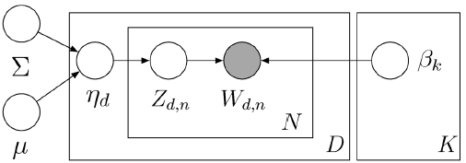
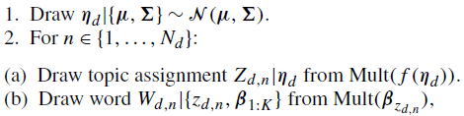

Related Work
A CORRELATED TOPIC MODEL OF SCIENCE, DAVID M. BLEI, 2007
Notes:
eta

Slide 6
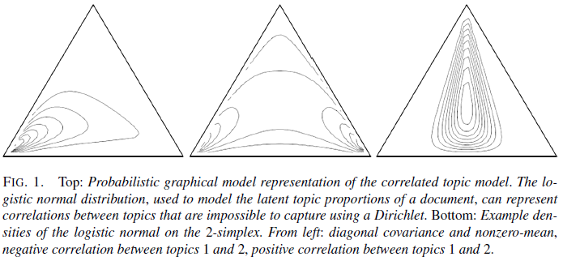
Related Work
A CORRELATED TOPIC MODEL OF SCIENCE, DAVID M. BLEI, 2007
Covariance of the Gaussian induces dependencies between the components of the transformed random simplicial vector, allowing for a general pattern of variability between its components.

Slide 7
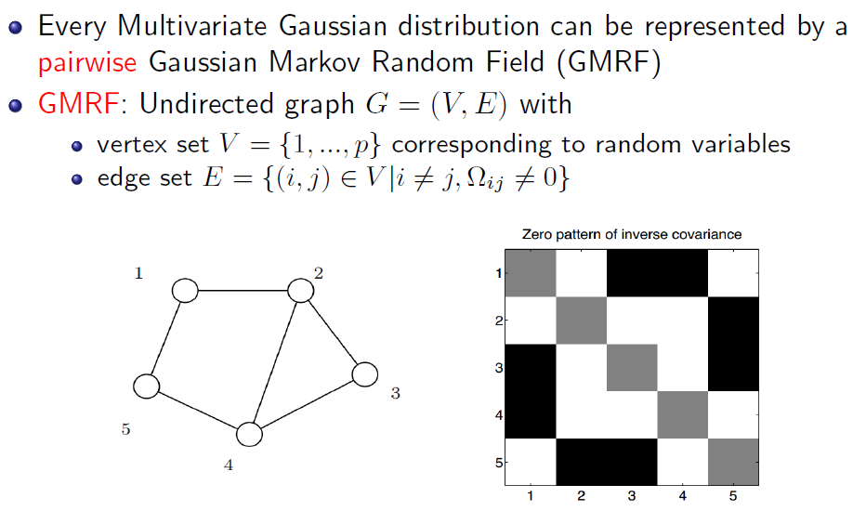
Related Work
A CORRELATED TOPIC MODEL OF SCIENCE, DAVID M. BLEI, 2007

Slide 8
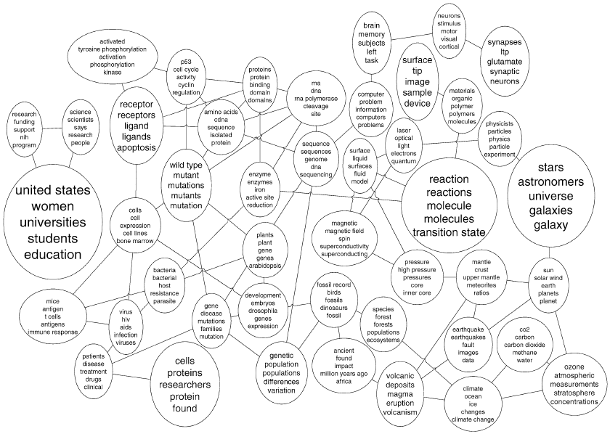
Related Work
A CORRELATED TOPIC MODEL OF SCIENCE, DAVID M. BLEI, 2007
Notes:
lasso

Slide 9
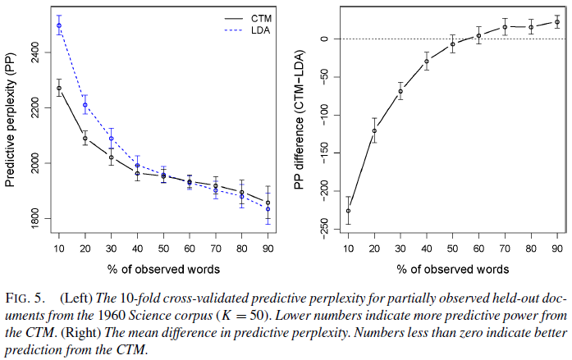
Related Work
A CORRELATED TOPIC MODEL OF SCIENCE, DAVID M. BLEI, 2007
Notes:
mean difference平均差

Slide 10
Related Work
A CORRELATED TOPIC MODEL OF SCIENCE, DAVID M. BLEI, 2007
Limitation：CTM inferences pairwise correlations and the non-conjugacy of logistic-normal prior impose inference complexity of O(K³)
[2011]CTM gives rise to spurious correlations resulting in a better perplexity on the heldout set even when the recovered topics are less interpretable

Slide 11
Related Work
Scalable Inference for Logistic-Normal Topic Models, Jun Zhu, 2013,NIPS
This paper derives a scalable Gibbs sampling algorithm based on data augmentation, which brings down the inference cost to O(K²) per document
To improve time efficiency, they further present a parallel implementation that can deal with large-scale applications and learn the correlation structures of thousands of topics from millions of documents

Slide 12
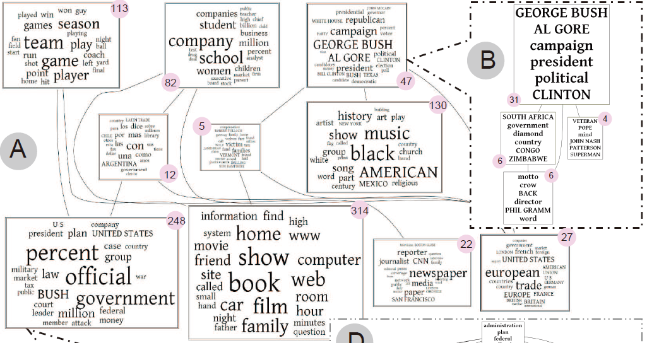
Related Work
Scalable Inference for Logistic-Normal Topic Models, Jun Zhu, 2013,NIPS

Slide 13
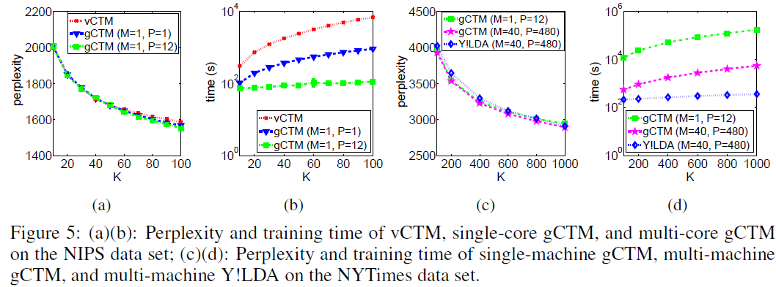
Related Work
Scalable Inference for Logistic-Normal Topic Models, Jun Zhu, 2013,NIPS

Slide 14
Related Work
Spectral Methods for Correlated Topic Models, 2016
This paper assumes that the hidden topic proportions are drawn from a flexible class of Normalized Infinitely Divisible (NID) distributions
The distribution of a real-valued random variable X is infinitely divisible if for every n∈N⁺, there exists a sequence of independent, identically distributed variables (X₁,X₂,…,X_{n}) such that X₁+X₂+⋯+X_{n} has the same distribution as X.
Notes:
无穷可分分布Poisson distribution, compound Poisson, the negative binomial distribution, Gamma distribution
The Dirichlet distribution is a special case obtained by normalizing a set of Gamma random variables

Slide 15
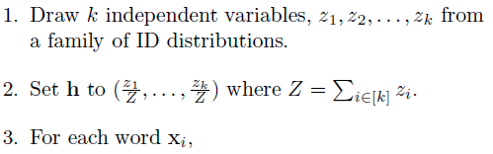
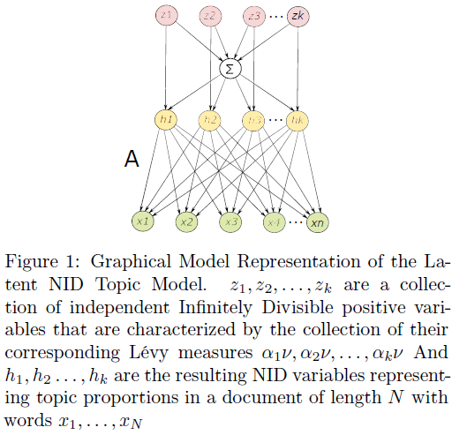
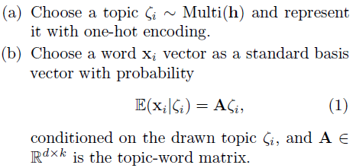
Related Work
Spectral Methods for Correlated Topic Models, 2016
Notes:
zeta

Slide 16
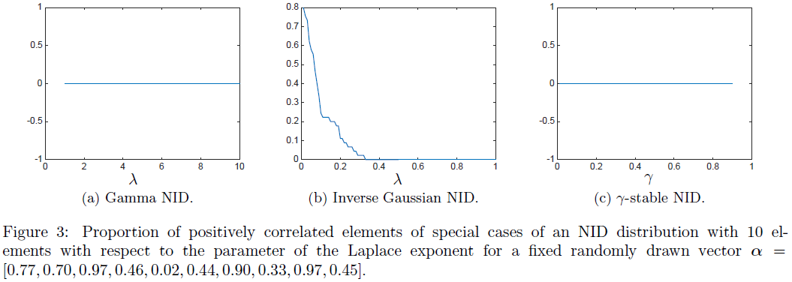
Related Work
Spectral Methods for Correlated Topic Models, 2016
The class of NID can incorporate both positive and negative correlations among the topics
Notes:
The Dirichlet
distribution is a special case obtained by normalizing
a set of Gamma random variables

Slide 17
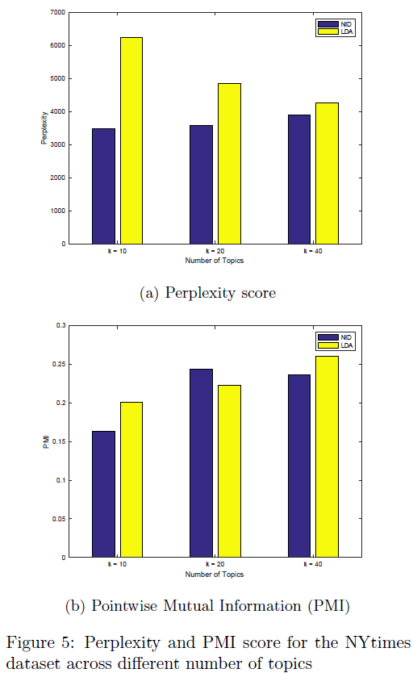
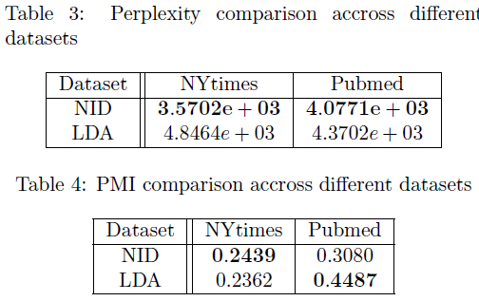
Related Work
Spectral Methods for Correlated Topic Models, 2016

Slide 18
Related Work
A Correlated Topic Model Using Word Embeddings, IJCAI, 2017
This paper proposes the Correlated Gaussian Topic Model (CGTM) to model both topics and topic correlations in the word embedding space
The motivation of this paper is to model topics in the word embedding space, exploit the known correlation information at word level and further improve the correlation discovery at topic level

Slide 19
Related Work
A Correlated Topic Model Using Word Embeddings, IJCAI, 2017
1. They learn word embeddings with the help of external large unstructured text corpora to obtain additional word-level correlation information
2. In the vector space of word embeddings,they model topics and topic correlations to exploit useful additional semantics in word embeddings, wherein each topic is represented as a Gaussian distribution over the word embeddings and topic correlations are learned among those Gaussian topics
3.They develop a Gibbs sampling algorithm

Slide 20
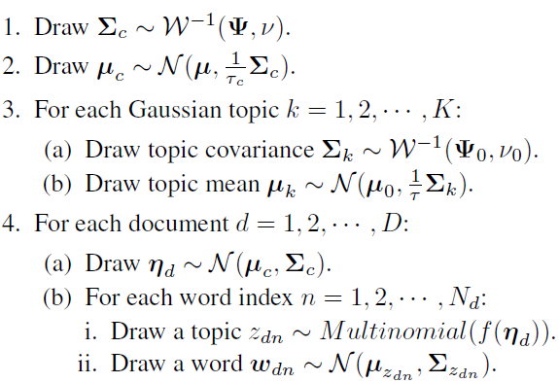
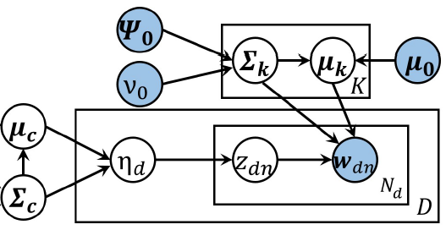
Related Work
A Correlated Topic Model Using Word Embeddings, IJCAI, 2017

Slide 21
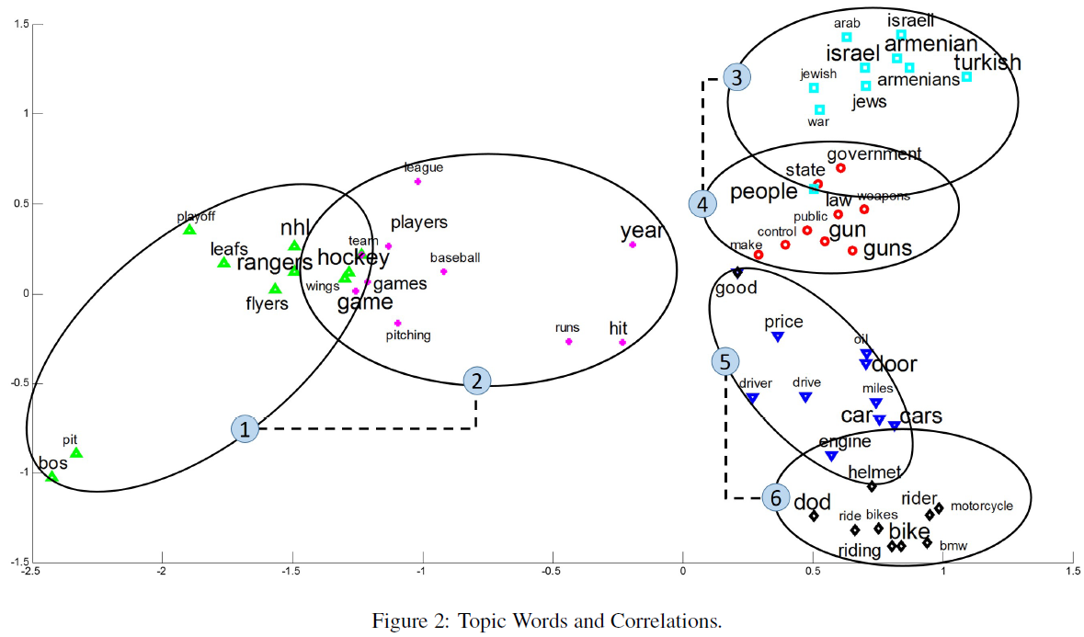
Related Work
A Correlated Topic Model Using Word Embeddings, IJCAI, 2017

Slide 22
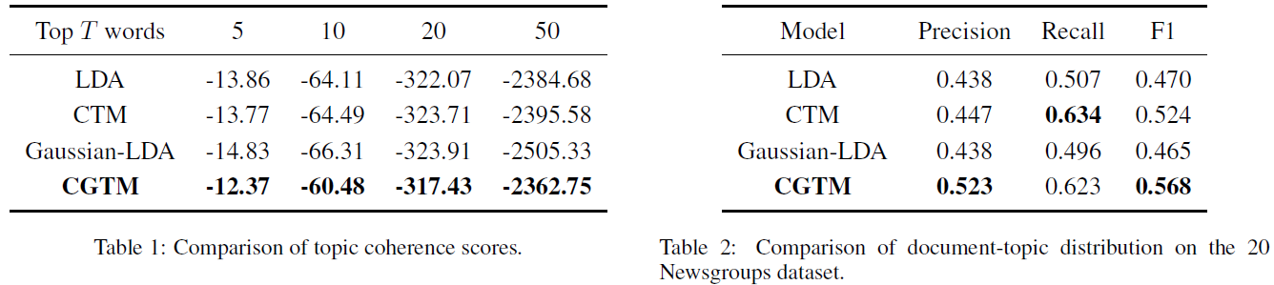
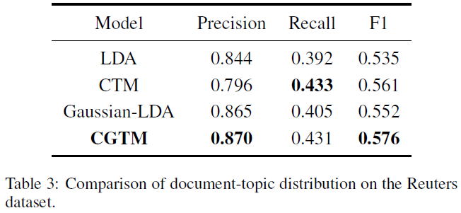
Related Work
A Correlated Topic Model Using Word Embeddings, IJCAI, 2017

Slide 23
Related Work
Efficient Correlated Topic Modeling with Topic Embedding, KDD, 2017
This paper proposes a new model which learns compact topic embeddings and captures topic correlations through the closeness between the topic vectors
Their method enables efficient inference in the low-dimensional embedding space, reducing previous cubic or quadratic time complexity to linear w.r.t the topic size.

Slide 24
Related Work
Efficient Correlated Topic Modeling with Topic Embedding, KDD, 2017
They induce continuous distributed representations for latent topics, and, as in word embeddings, expect topics with relevant semantics to be close to each other in the embedding space
They further embed documents into the same vector space, and characterize document’s topic proportions with its distances to the topics

Slide 25
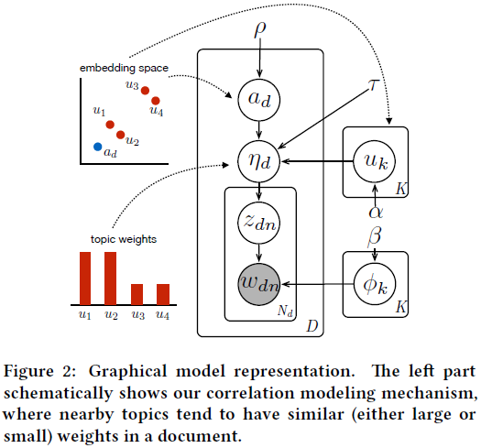
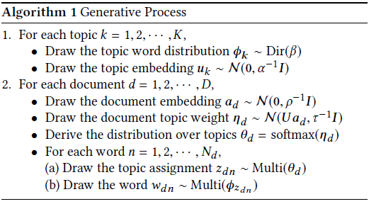
Related Work
Efficient Correlated Topic Modeling with Topic Embedding, KDD, 2017

Slide 26
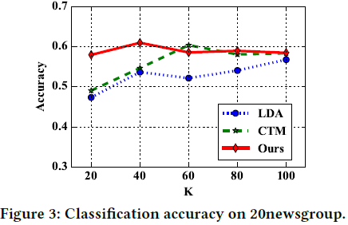
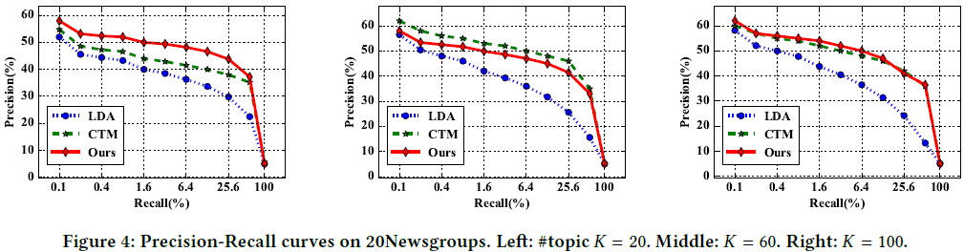
Related Work
Efficient Correlated Topic Modeling with Topic Embedding, KDD, 2017

Slide 27
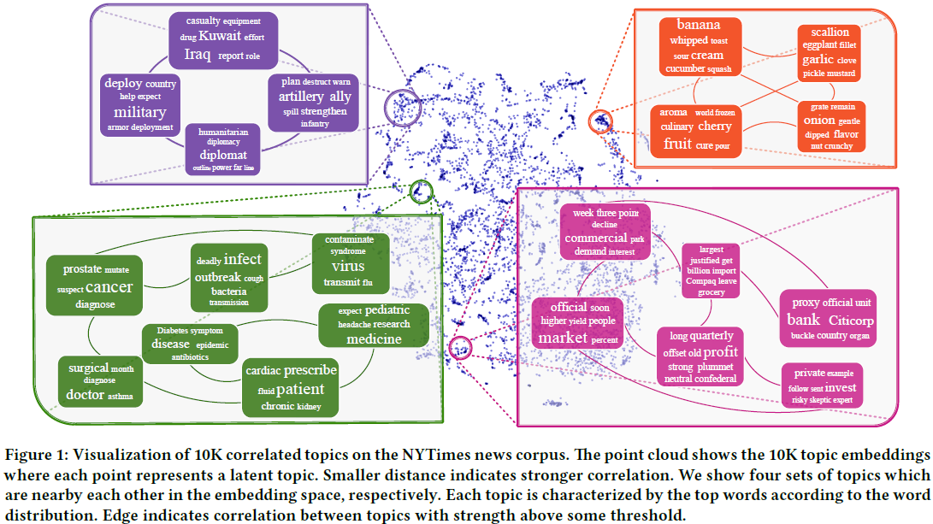
Related Work
Efficient Correlated Topic Modeling with Topic Embedding, KDD, 2017

Slide 28
My thoughts
Leveraging MRF and CRF regularized model to enhance the topic coherence.
Exploting RNN to evaluate the Strength of the correlation beween words
Using a Gibbs sampling solution with data augmentation to perform inference

Slide 29
Thank You!

